Slide 1

Image classification
Slides adapted from Fei-Fei Li, Rob Fergus, Antonio Torralba, and others

Slide 2
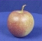
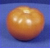
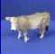
The statistical learning framework
Apply a prediction function to a feature representation of the image to get the desired output:
f( ) = “apple”
f( ) = “tomato”
f( ) = “cow”

Slide 3
The statistical learning framework
y = f(x)
Training: given a training set of labeled examples {(x₁,y₁), …, (x_{N},y_{N})}, estimate the prediction function f by minimizing the prediction error on the training set
Testing: apply f to a never before seen test example x and output the predicted value y = f(x)
output
prediction function
Image feature

Slide 4
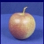
Steps
Training
Training Labels
Training Images
Image Features
Training
Learned model
Learned model
Testing
Image Features
Prediction
Test Image
Slide credit: D. Hoiem

Slide 5
Traditional recognition pipeline
Hand-designed feature extraction
Trainable classifier
Image
Pixels
Object Class
Features are not learned
Trainable classifier is often generic (e.g. SVM)

Slide 6
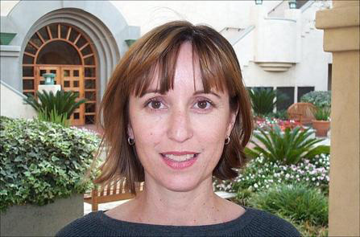
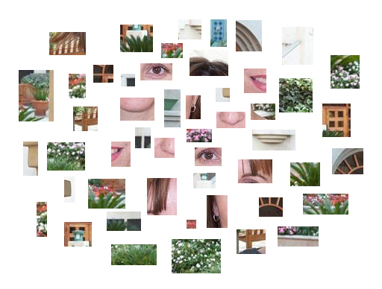
Bags of features

Slide 7
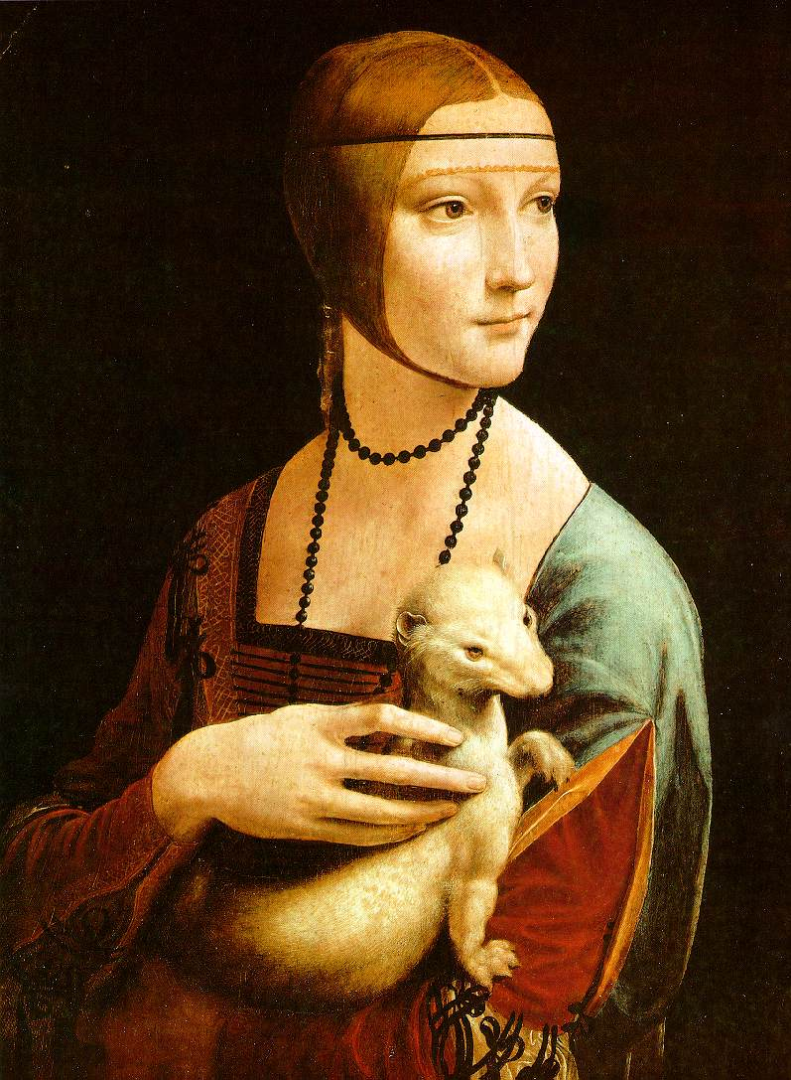
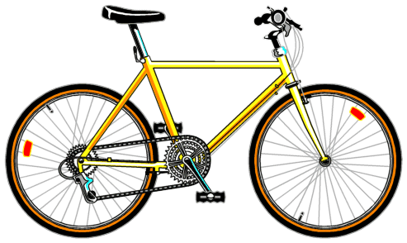
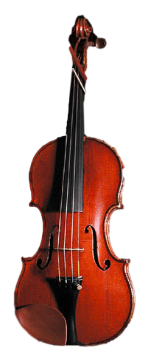
Traditional features: Bags-of-features
Extract local features
Learn “visual vocabulary”
Quantize local features using visual vocabulary
Represent images by frequencies of “visual words”

Slide 8
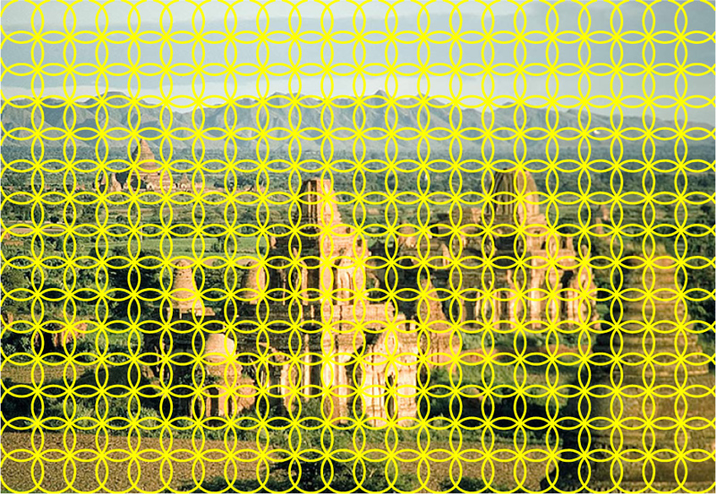
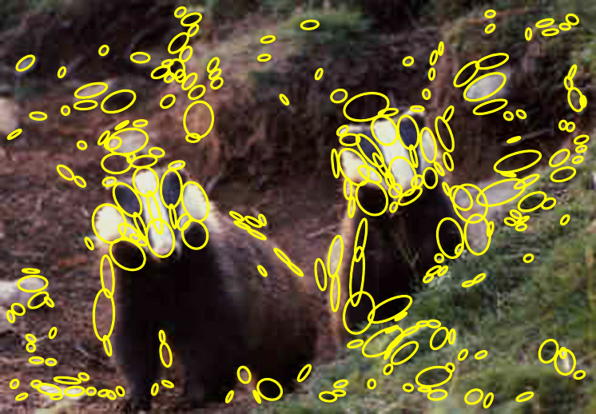
1. Local feature extraction
Sample patches and extract descriptors

Slide 9
2. Learning the visual vocabulary
…
Extracted descriptors from the training set
Slide credit: Josef Sivic

Slide 10
2. Learning the visual vocabulary
…
Clustering
Slide credit: Josef Sivic

Slide 11
2. Learning the visual vocabulary
Visual vocabulary
…
Clustering
Slide credit: Josef Sivic

Slide 12
Review: K-means clustering
Want to minimize sum of squared Euclidean distances between features x_{i} and their nearest cluster centers m_{k}
Algorithm:
Randomly initialize K cluster centers
Iterate until convergence:
Assign each feature to the nearest center
Recompute each cluster center as the mean of all features assigned to it

Slide 13
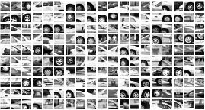
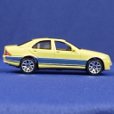
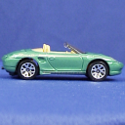

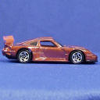
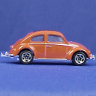
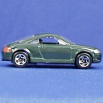
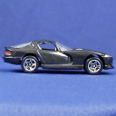
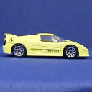
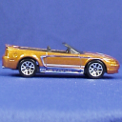
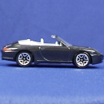
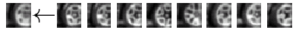
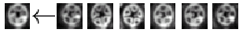
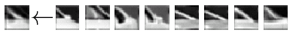
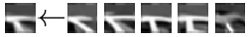
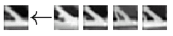
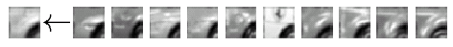
Example visual vocabulary
…
Appearance codebook
Source: B. Leibe

Slide 14
Bag-of-features steps
Extract local features
Learn “visual vocabulary”
Quantize local features using visual vocabulary
Represent images by frequencies of “visual words”

Slide 15
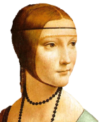
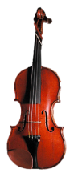
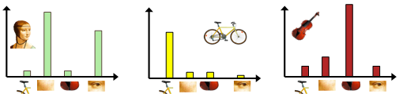





Bag-of-(Visual)Words (BoW) model:
(i) Feature extraction; (ii) Dictionary learning and Feature encoding; (iii) pooling
Original images
Feature extraction
(SIFT/HOG, etc)
Histogram
Visual word ($x_{i}$)
Feature pooling
(average pooling)
Codebook generation (k-means)
Feature encoding
(Feature quantization)
Codeword (U_{i})
Cluster index(v)
(credited to Fei-Fei Li)

Slide 16
Bags of features: Motivation
Orderless document representation: frequencies of words from a dictionary Salton & McGill (1983)

Slide 17
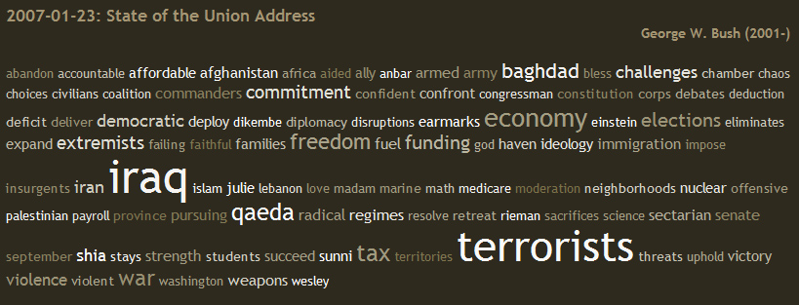
Bags of features: Motivation
Orderless document representation: frequencies of words from a dictionary Salton & McGill (1983)
US Presidential Speeches Tag Cloud http://chir.ag/projects/preztags/

Slide 18
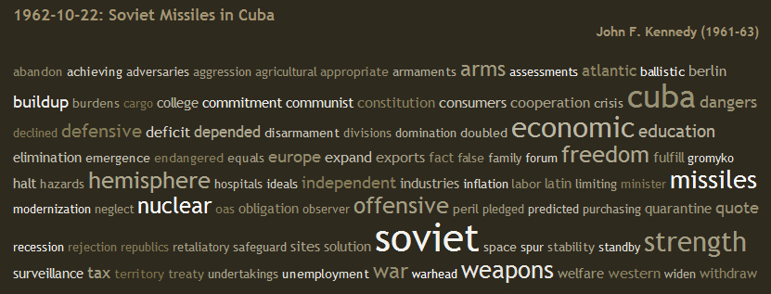
Bags of features: Motivation
Orderless document representation: frequencies of words from a dictionary Salton & McGill (1983)
US Presidential Speeches Tag Cloud http://chir.ag/projects/preztags/

Slide 19
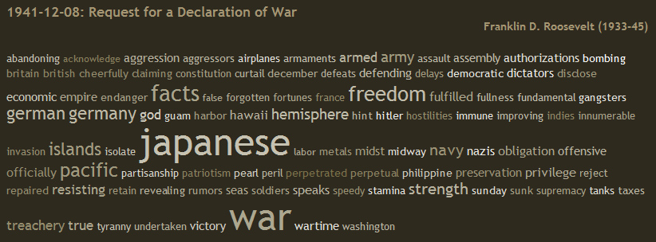
Bags of features: Motivation
Orderless document representation: frequencies of words from a dictionary Salton & McGill (1983)
US Presidential Speeches Tag Cloud http://chir.ag/projects/preztags/

Slide 20

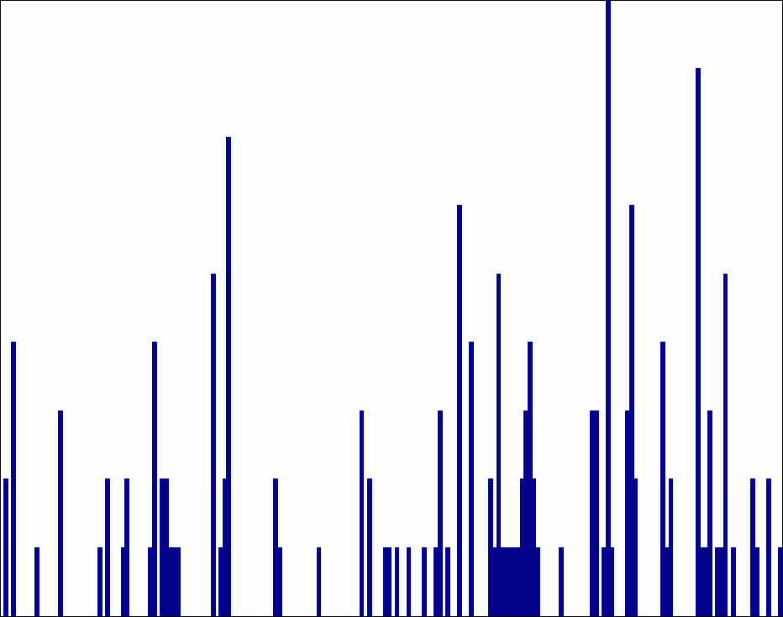
Spatial pyramids
level 0
Lazebnik, Schmid & Ponce (CVPR 2006)

Slide 21


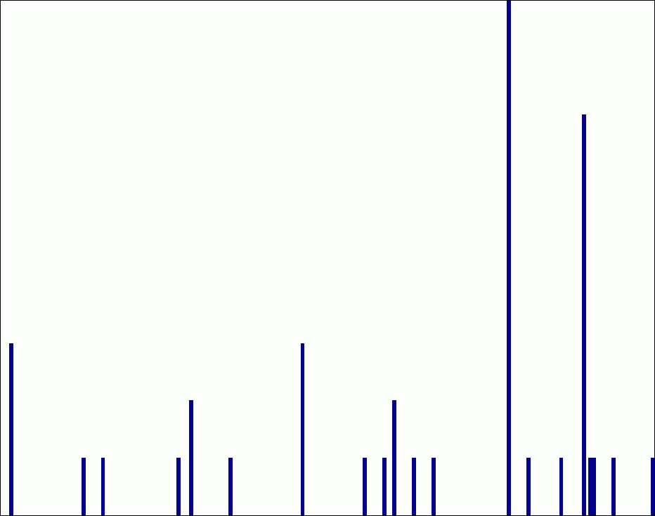
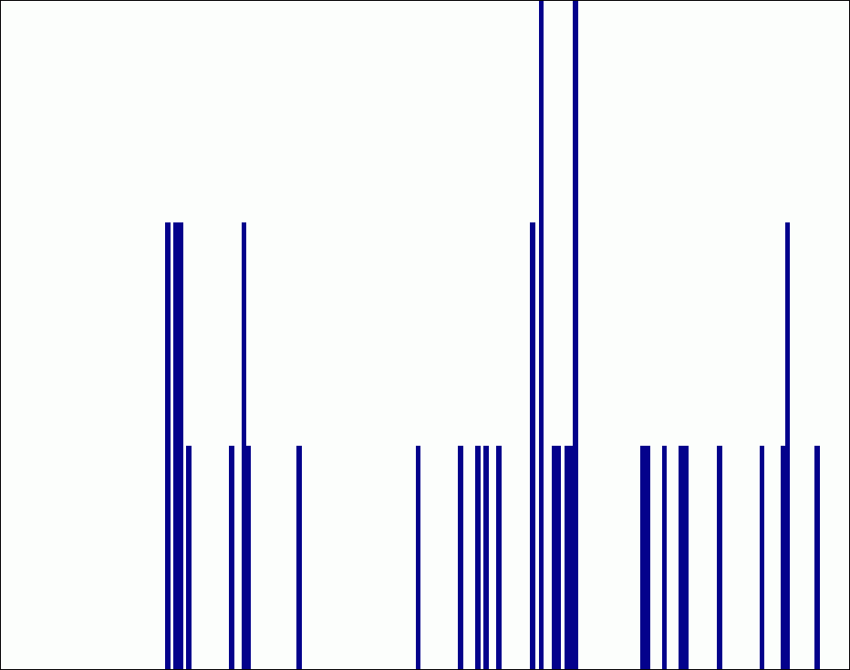
Spatial pyramids
level 0
level 1
Lazebnik, Schmid & Ponce (CVPR 2006)

Slide 22
















Spatial pyramids
level 0
level 1
level 2
Lazebnik, Schmid & Ponce (CVPR 2006)

Slide 23
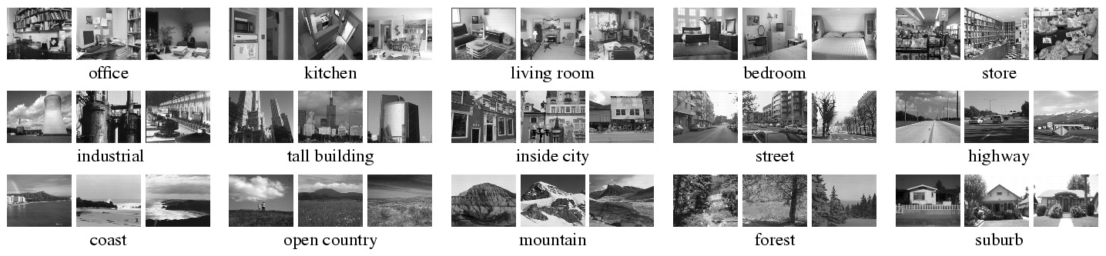
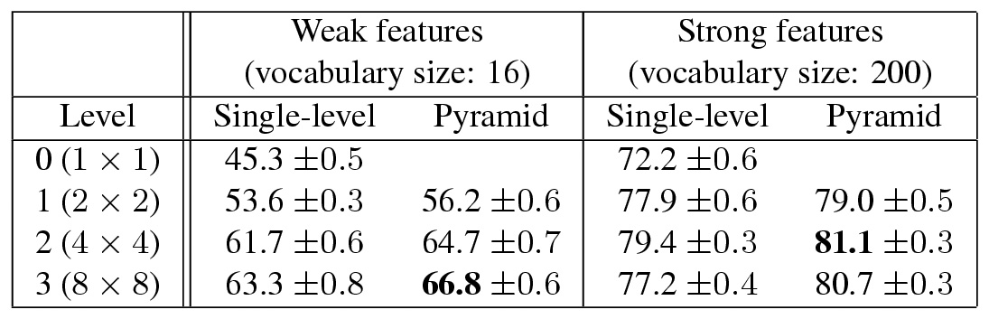
Spatial pyramids
Scene classification results

Slide 24
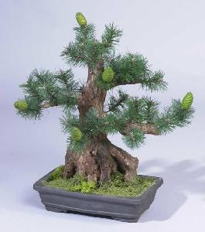
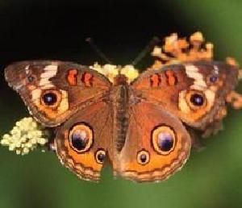
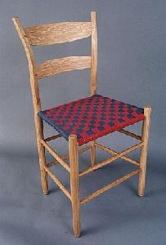
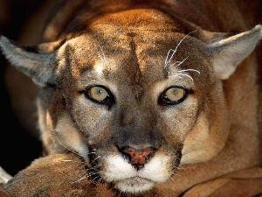

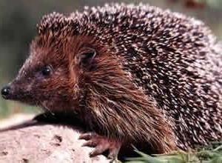
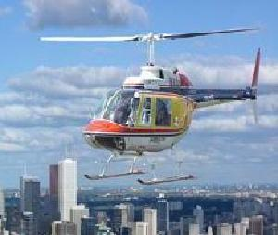
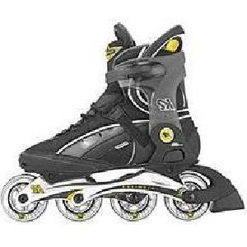
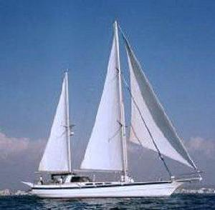

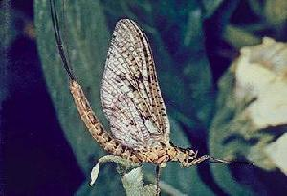
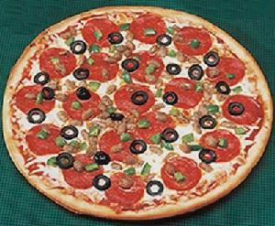
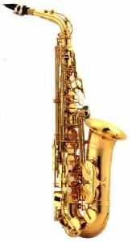
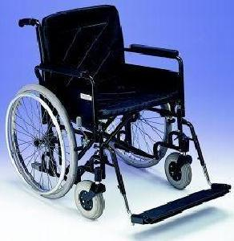

Spatial pyramids
Caltech101 classification results

Slide 25
Traditional recognition pipeline
Hand-designed feature extraction
Trainable classifier
Image
Pixels
Object Class

Slide 26
Classifiers: Nearest neighbor
Test example
Training examples from class 2
Training examples from class 1
f(x) = label of the training example nearest to x
All we need is a distance function for our inputs
No training required!
Notes:
“Non-parametric” classifier: the entire training set is essentially the model parameters.
Pros:
Very fast at training time
Flexible: all it requires is a way to compute similarity or distances between pairs of features. Applies to many different kinds of features.
Works with any number of classes.
Works well in practice for large datasets (but see cons)
Cons:
Slow at test time (need to compute distances between test example and every training example)

Slide 27

K-nearest neighbor classifier
For a new point, find the k closest points from training data
Vote for class label with labels of the k points
k = 5

Slide 28

K-nearest neighbor classifier
Which classifier is more robust to outliers?
Credit: Andrej Karpathy, http://cs231n.github.io/classification/

Slide 29

K-nearest neighbor classifier
Credit: Andrej Karpathy, http://cs231n.github.io/classification/

Slide 30
Linear classifiers
Find a linear function to separate the classes:
f(x) = sgn(w ⋅ x + b)
Notes:
“Parametric” classifier: model defined by a small number of parameters (w, b)
Pros:
Very fast at test time
Cons:
Slow at training time: need to estimate the parameters
Only works for two classes
Data may not be linearly separable

Slide 31
Nearest neighbor vs. linear classifiers
NN pros:
Simple to implement
Decision boundaries not necessarily linear
Works for any number of classes
Nonparametric method
NN cons:
Need good distance function
Slow at test time
Linear pros:
Low-dimensional parametric representation
Very fast at test time
Linear cons:
Works for two classes
How to train the linear function?
What if data is not linearly separable?

Slide 32
Support vector machines
When the data is linearly separable, there may be more than one separator (hyperplane)
Which separator is best?

Slide 33
Support vector machines
Find hyperplane that maximizes the margin between the positive and negative examples
For support vectors,
Distance between point and hyperplane:
Therefore, the margin is 2 / ||w||
Support vectors
Margin
C. Burges, A Tutorial on Support Vector Machines for Pattern Recognition, Data Mining and Knowledge Discovery, 1998

Slide 34
Finding the maximum margin hyperplane
Maximize margin 2 / ||w||
Correctly classify all training data:
Quadratic optimization problem:
C. Burges, A Tutorial on Support Vector Machines for Pattern Recognition, Data Mining and Knowledge Discovery, 1998

Slide 35
SVM parameter learning
Separable data:
Non-separable data:
Maximize margin
Classify training data correctly
Maximize margin
Minimize classification mistakes

Slide 36

SVM parameter learning
+1
Margin
0
-1
Demo: http://cs.stanford.edu/people/karpathy/svmjs/demo

Slide 37

Nonlinear SVMs
General idea: the original input space can always be mapped to some higher-dimensional feature space where the training set is separable
Φ: x → φ(x)
Image source

Slide 38
Nonlinear SVMs
Linearly separable dataset in 1D:
Non-separable dataset in 1D:
We can map the data to a higher-dimensional space:
0
x
0
x
x²
0
x
Slide credit: Andrew Moore

Slide 39
The kernel trick
General idea: the original input space can always be mapped to some higher-dimensional feature space where the training set is separable
The kernel trick: instead of explicitly computing the lifting transformation φ(x), define a kernel function K such that K(x , y) = φ(x) · φ(y)
(to be valid, the kernel function must satisfy Mercer’s condition)

Slide 40
The kernel trick
Linear SVM decision function:
learned weight
Support vector
C. Burges, A Tutorial on Support Vector Machines for Pattern Recognition, Data Mining and Knowledge Discovery, 1998

Slide 41
The kernel trick
Linear SVM decision function:
Kernel SVM decision function:
This gives a nonlinear decision boundary in the original feature space
C. Burges, A Tutorial on Support Vector Machines for Pattern Recognition, Data Mining and Knowledge Discovery, 1998

Slide 42


Polynomial kernel:

Slide 43

Gaussian kernel
Also known as the radial basis function (RBF) kernel:
K(x, y)
||x – y||

Slide 44

Gaussian kernel
SV’s

Slide 45
Kernels for histograms
Histogram intersection:
Square root (Bhattacharyya kernel):

Slide 46
SVMs: Pros and cons
Pros
Kernel-based framework is very powerful, flexible
Training is convex optimization, globally optimal solution can be found
Amenable to theoretical analysis
SVMs work very well in practice, even with very small training sample sizes
Cons
No “direct” multi-class SVM, must combine two-class SVMs (e.g., with one-vs-others)
Computation, memory (esp. for nonlinear SVMs)

Slide 47

Generalization
Generalization refers to the ability to correctly classify never before seen examples
Can be controlled by turning “knobs” that affect the complexity of the model
Training set (labels known)
Test set (labels unknown)

Slide 48
Diagnosing generalization ability
Training error: how does the model perform on the data on which it was trained?
Test error: how does it perform on never before seen data?
Underfitting
Overfitting
Error
Test error
Training error
Low
Model complexity
High
Source: D. Hoiem

Slide 49

Underfitting and overfitting
Underfitting: training and test error are both high
Model does an equally poor job on the training and the test set
Either the training procedure is ineffective or the model is too “simple” to represent the data
Overfitting: Training error is low but test error is high
Model fits irrelevant characteristics (noise) in the training data
Model is too complex or amount of training data is insufficient
Underfitting
Good generalization
Overfitting
Figure source

Slide 50
Effect of training set size
Few training examples
Test Error
Many training examples
Low
Model complexity
High
Source: D. Hoiem
Notes:
Note: these figures don’t work in pdf

Slide 51
Validation
Split the data into training, validation, and test subsets
Use training set to optimize model parameters
Use validation test to choose the best model
Use test set only to evaluate performance
Stopping point
Test set loss
Error
Validation
set loss
Training set loss
Model complexity

Slide 52
Homework
Bag of visual words based image representation + SVM for image classification on the Caltech 256 dataset.
Spatial Pyramid Matching based image representation + SVM for image classification on the Caltech 256 dataset.
SVM: LibSVM (Linear kernel and Histogram Intersection kernel )
Training number for each class: 15 30 45 60
Report + codes.
Report includes the accuracy, all the free-parameters used in your experiments.
Due date: March 28 (No extension)

